Slide 1
Team Stats 2 Crew
DDS Case Study 1: Beers and Breweries

Slide 2
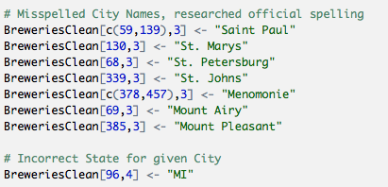
Data Investigation: Breweries
While reviewing the Breweries data set it appeared that duplicates could exist. Via base R sorting and text functions cleanup of City spellings and duplicated Brewery names was done. In particular we found that City names containing “St” were missing “.” and others had “Mt.” rather than “Mount”. Google search was used to verify Names. One name was misspelled twice, Menomonie in WI. It was also found that City name ”Marquette” was not found in MA, only in MI.

Slide 3
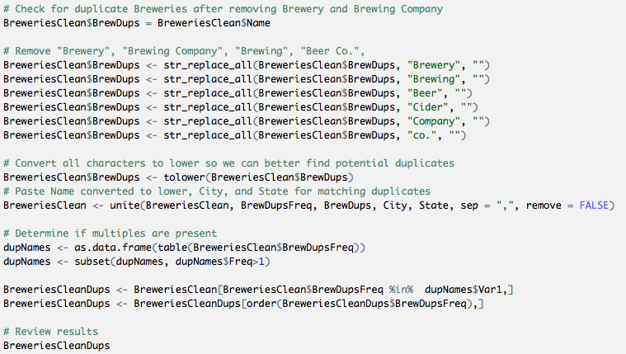
Data Investigation: Breweries
To better identify what could truly be duplicated rows, a combination of an adjusted Name, City, and State was used to determine frequency of occurrence. If that value was greater than 1 further investigation was necessary.

Slide 4
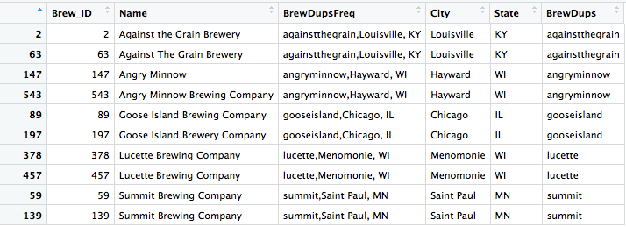
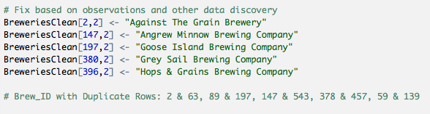
Data Investigation: Breweries
Even with these handy functions we still had to find a few more issues visually within the data. Those were slightly more difficult to find given slight differences in spelling or other special scenarios…
Too close to call, will leave as is

Slide 5
Data Investigation: Breweries
While many of the similarities could be addressed programmatically via string functions, some more complex scenarios required manual intervention. It is because of this we have the following recommendations for implementation to avoid this issues going forward:
Minimize use of acronyms unless official names contain them
Generate mechanism to validate City and State combinations to catch errors
Implement common naming strategy for the sake of consistency (Co. vs Company)

